Slide 1
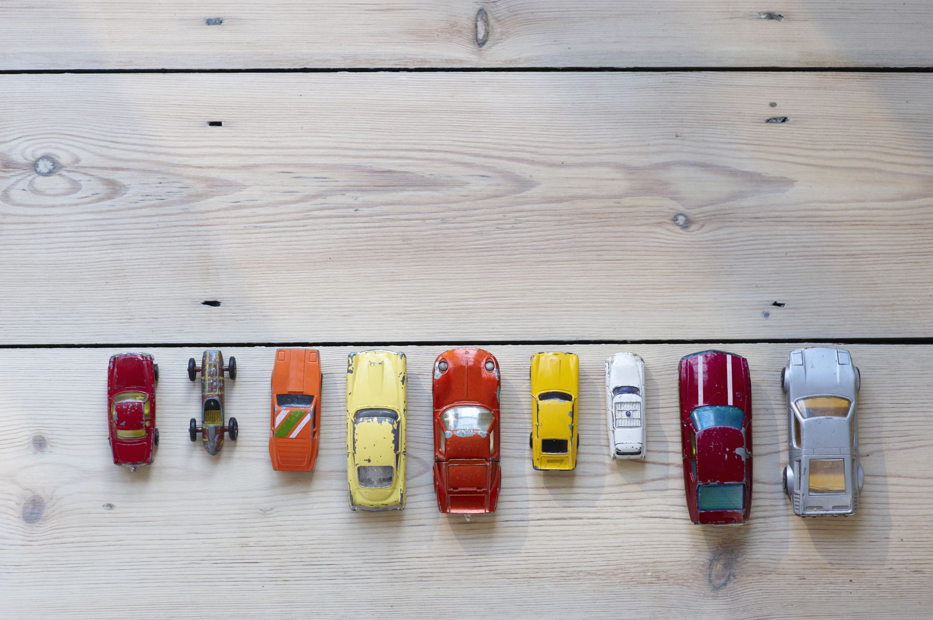
CAR 4 U
Dr. Rakhee Chhibber

Slide 2
Objective / questions of Analysis
Which type of cars are preferred by the customers prefer 2 Seat cars?
Which car price is higher?
How price related to age of car?
Whether customers prefer to purchase the First owner rather or the Second or Third owner car.
Which type of car customers prefers to purchase? Electric or non-electric.
Which Automatic or Manual transmission is easier to operate a car?

